Slide 1
LGA: a method for finding 3D similarities in protein structures
Adam Zemla
Nucleic Acids Research, 2003, Vol. 31, No. 13
Speaker: Chun-Jen Chen
Date: June 23, 2009

Slide 2
Abstract
We present the LGA (Local-Global Alignment) method, designed to facilitate the comparison of protein structures or fragments of protein structures in sequence dependent and sequence independent modes. The LGA structure alignment program is available as an online service at http://PredictionCenter.llnl.gov/local/lga. Data generated by LGA can be successfully used in a scoring function to rank the level of similarity between two structures and to allow structure classification when many proteins are being analyzed. LGA also allows the clustering of similar fragments of protein structures.
115/11/07

Slide 3
Introduction
A small perturbation in just one part of the protein (e.g. in a hinge joining two domains) can create a large RMSD and it would seem that the two structures are very different overall.
Thus, it is desirable to also consider local regions of the proteins in assessing their similarity.

Slide 4
LGA
LCS (longest continuous segments)
  LCS procedure is able to localize and superimpose the longest segments of residues that can fit under a selected RMSD cutoff.
GDT (global distance test)
  The GDT algorithm is designed to complement evaluations made with LCS searching for the largest (not necessary continuous) set of ‘equivalent’ residues that deviate by no more than a specified distance cutoff.

Slide 5
LCS (longest continuous segments)
兩條Sequences中找出最長且RMSD小於某個定值的Substring(continuous)
此RMSD值包含了這兩條的旋轉角度，GDT根據此旋轉角度將每個對應到的位置中距離小於distance cutoff的原子當作OUTPUT集合

Slide 6
GDT_TS
GDT_TS =(P1 + P2 + P4 + P8)/4
  Pd is a percent of residues from model1 that can be superimposed with corresponding residues from model2 under selected distance cutoffs d = 1, 2, 4, 8

Slide 7
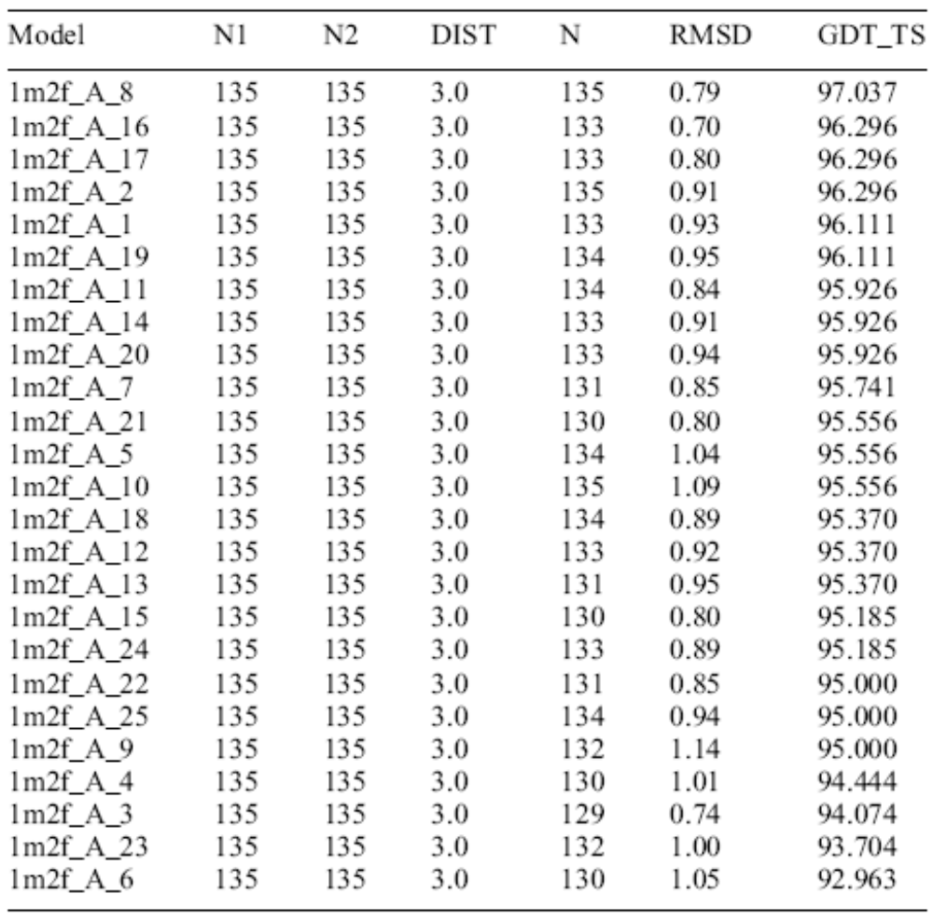

Slide 8
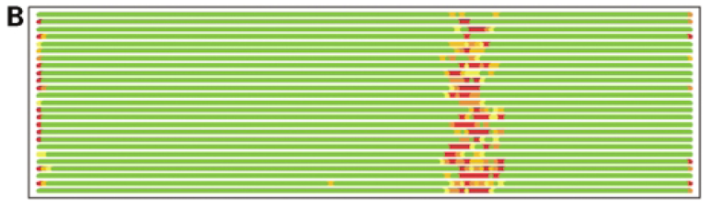
Residues superimposed below 1.0Å are in green, below 2.0Å in yellow, below 3.0Å in orange, below 4.0Å in brown and residues at or above 4.0Å in red

Slide 9
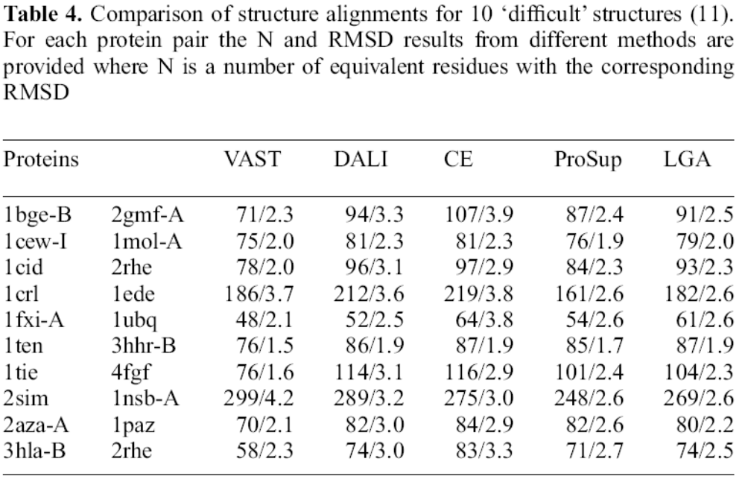
Comparison

Slide 10
